Slide 1
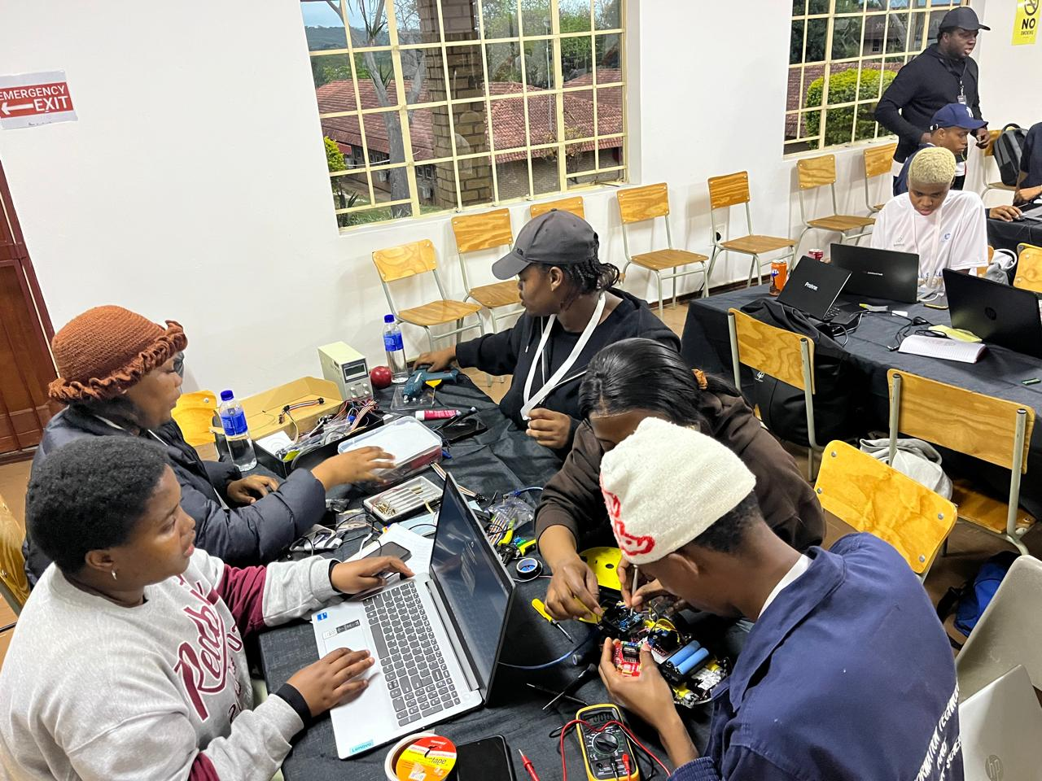
The AgriTwin-Smart-Rover
INTRODUCTION:
We’re pleased to present our project, the AgriTwin Rover. It is a smart agricultural system that uses robotics, sensors and technology to monitor crop conditions and assist farmers.
But before we introduce our solution, let us first look at the problem we are trying to solve

Slide 2


Slide 3
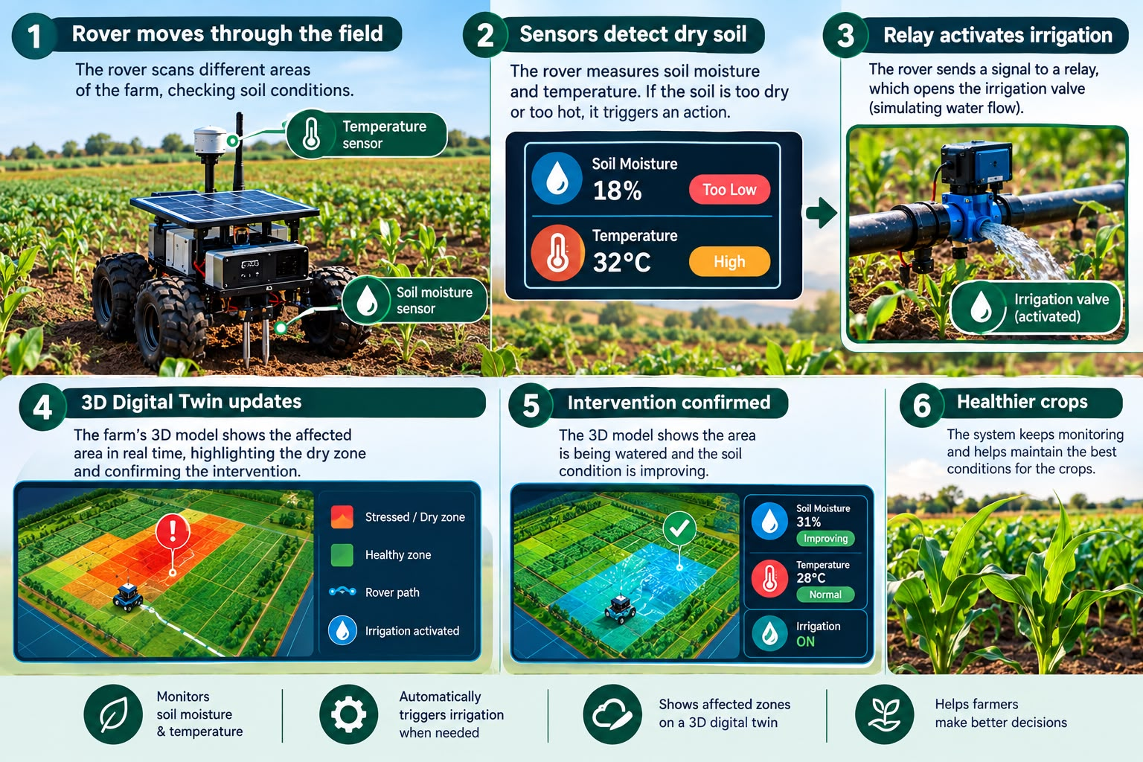
OUR PROBLEM STATEMENT
In the lowveld region, macadamia and citrus crops are vital economic drivers, but climate volatility and sudden dry spells threaten crop’s wealth. Traditionally fixed sensors are too costly to deploy across every area leaving dangerous blind spot.

Slide 4
OUR CHALLENGE
Our challenge was to create a smart rover that can move through farm areas, monitor soil conditions, detect areas under stress, sense temperature around the field and respond automatically

Slide 5
OUR OUTCOME SOLUTION
To solve this problem, our team built the AgriTwin Rover, a mobile smart edge node integrated with a 3D digital twin. Instead of relying on stationery equipments, our 4-wheel rover actively patrols sub-plots, powered by an ARDUINO UNO.

Slide 6
WHAT DOES IT DO
It constantly measures soil moisture, ambient temperature and checks for physical obstacles using ultrasonic sensor.
HERE’S HOW THE CLOSED LOOP SYSTEM WORKS:
When the soil moisture drops below 30%,the soil moisture immediately detects dry soil
The RED led flashes on, drive motor stops and the onboard water pump activates the deliver precise spot-irrigation right at the root zone.
Once moisture levels recover, the GREEN led turns ON, the pump shuts off and the resume it patrol

Slide 7
WHY OUR SOLUTION STANDS OUT?
It brings the technology directly to the crops. Instead of waiting for problems to be noticed, the AgriTwin Rover moves around the field, collects information, identifies areas that need attention, and responds automatically.
AgriTwin Rover saves water, cuts hardware costs and defends crops against climate risks.

Slide 8
IS IT COMMERCIALLY PURCHASABLE
Commercially, AgriTwin is highly profitable and scalable. Each Rover costs R1,100 to build and we retail it at R3,500, giving us a 70% margin

